Slide 1
Chart Infographics
Is a great way to visualize information about users
Transactions, 25%
There are people who have a significant number of followers in every business.
Payments, 45%
Sales Report
There are people who have a significant number of followers in every business.
Product, 40%
There are people who have a significant number of followers in every business.

Slide 2
c
Chart Infographics
Customers, most businesses already know that platforms.
Is a great way to visualize information about users
Analysis of different brands and products.
Sales, most businesses already know that platforms.
$672
There are people who have a significant number of followers in every business domain. There are people who have a significant number of followers in every business domain on social media.
Payments, most businesses already know that platforms.

Slide 3
Chart Infographics
Is a great way to visualize information about users
Analysis of different brands and products.
There are people who have a significant number of followers in every business domain.
Customer
Product
Marketing

Slide 4
Chart Infographics
Is a great way to visualize information about users
$14,750
Product 01
There are people who have a significant number of followers in every business domain.
$56,924
Product 02
There are people who have a significant number of followers in every business domain.
$76,257
Product 03
There are people who have a significant number of followers in every business domain.

Slide 5
Chart Infographics
Is a great way to visualize information about users
There are people who have a significant number of followers in every business domain. There are people who have a significant number of followers in every business domain on social media.
2020
Customer
Product
Marketing

Slide 6
Chart Infographics
Is a great way to visualize information about users
Product 01
Product 02
Product 03
55%
25%
40%
Customer
Customer
Customer
There are people who have a significant number.
There are people who have a significant number.
There are people who have a significant number.

Slide 7
Chart Infographics
Payments
30%
There are people who have a significant number of followers in every business.
Is a great way to visualize information about users
Payments
17%
There are people who have a significant number of followers in every business.
Analysis of different brands and products.
There are people who have a significant number of followers in every business domain. There are people who have a significant number of followers in every business domain on social media.
Payments
70%
There are people who have a significant number of followers in every business.

Slide 8
Chart Infographics
Is a great way to visualize information about users
Customers, most businesses already know that platforms.
Sales, most businesses already know that platforms.
Payments, most businesses already know that platforms.
Payments, most businesses already know that platforms.

Slide 9
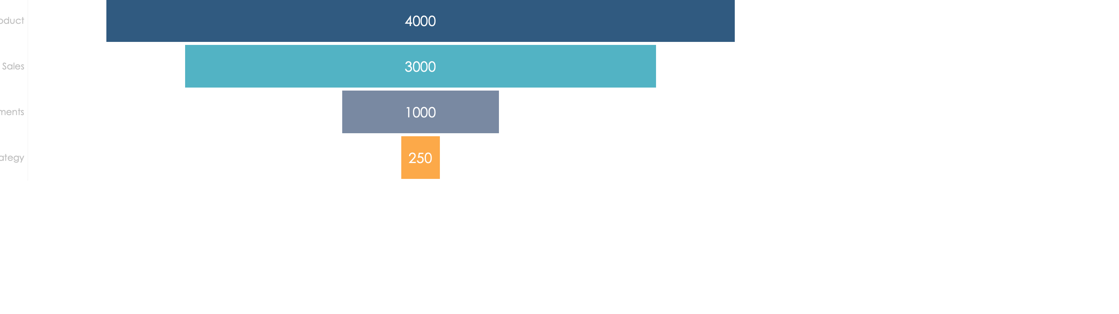
Chart Infographics
Is a great way to visualize information about users
Product Name
5000
There are people who have a significant number.
There are people who have a significant number of followers in every business domain.

Slide 10
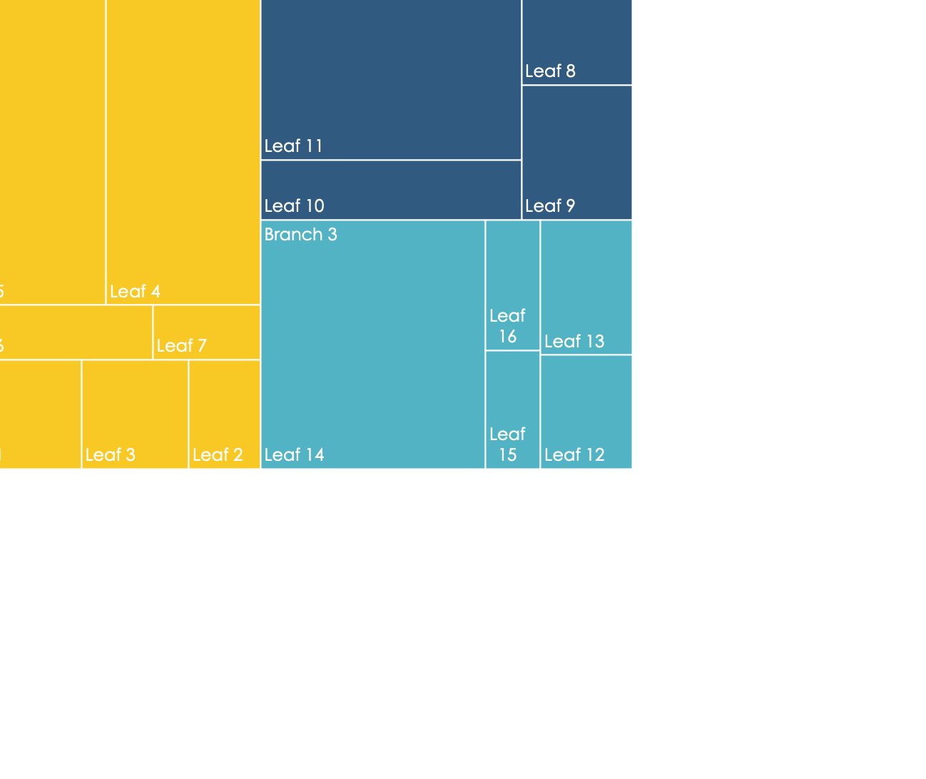
Chart Infographics
Is a great way to visualize information about users
Payments
30%
There are people who have a significant number of followers in every business.
Transactions
17%
There are people who have a significant number of followers in every business.
Sales
70%
There are people who have a significant number of followers in every business.

Slide 11
Chart Infographics
Is a great way to visualize information about users
Customer 01
There are people who have a significant number.
Customer 02
There are people who have a significant number.
Payments
Transactions
Products
There are people who have a significant number.
There are people who have a significant number.
There are people who have a significant number.

Slide 12
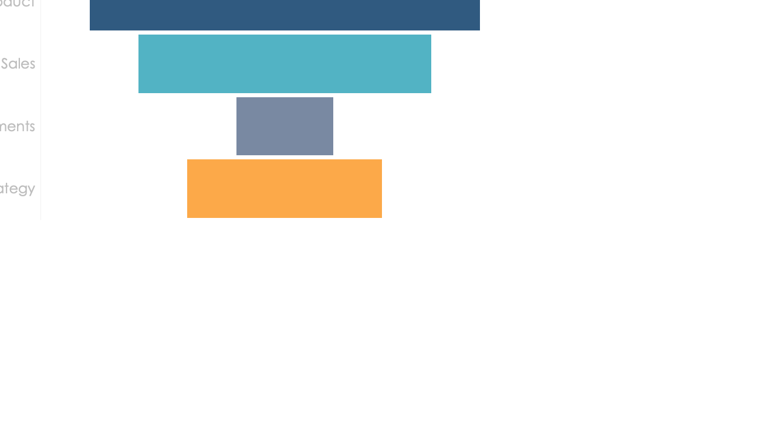

Chart Infographics
Is a great way to visualize information about users
Payments
Sales
There are people who have a significant number of followers in every business.
There are people who have a significant number of followers in every business.

Slide 13
Chart Infographics
Is a great way to visualize information about users
Analysis of different brands and products.
Business professionals like you connecting. Promotions only work as well.
Business professionals like you connecting. Promotions only work as well.
Product 01
24%
Product 02
50%

Slide 14
Chart Infographics
Is a great way to visualize information about users
70K
29K
Sales 01
Product Name
Sales 02
Business professionals like you connecting to share advice.
Business professionals like you connecting to share advice.
55% Increase
45% Increase

Slide 15
There are people who have a significant number of followers in every business.
Product 01
Product 02
Product 03
+570

Slide 16
Chart Infographics
Is a great way to visualize information about users
Analysis of different brands and products.
Business professionals like you connecting. Promotions only work as well.
Business professionals like you connecting. Promotions only work as well.
Payments
There are people who have a significant number of followers in every business.
30%

Slide 17
Chart Infographics
Is a great way to visualize information about users
Payments
Payments
There are people who have a significant number of followers in every business.
There are people who have a significant number of followers in every business.
30%
17%
Product Sales
Payments
Payments
There are people who have a significant number of followers in every business.
There are people who have a significant number of followers in every business.
70%
70%

Slide 18
Chart Infographics
Is a great way to visualize information about users
Analysis of different brands and products.
There are people who have a significant number of followers in every business domain. There are people who have a significant number of followers in every business domain on social media.
Sales schedule implementation plan
$2940

Slide 19
Chart Infographics
Is a great way to visualize information about users
Analysis of different brands and products.
There are people who have a significant number of followers in every business domain. There are people who have a significant number of followers in every business domain on social media.
45K
12K
Payments
Transactions
+5000
$725K
Product
Sales

Slide 20
Chart Infographics
Is a great way to visualize information about users
Payments
Transactions
Products
There are people who have a significant number of followers in every business domain.
There are people who have a significant.
There are people who have a significant.
There are people who have a significant.

